Slide 1

Coffee, Tea, Herbs, & Spices
Global Imports and Exports
Data Analysis Project
Presented by:
Adam Sadowy, Olena Rebani, Thi Ngo, Josie Boyer, and Shawn Tossi

Slide 2

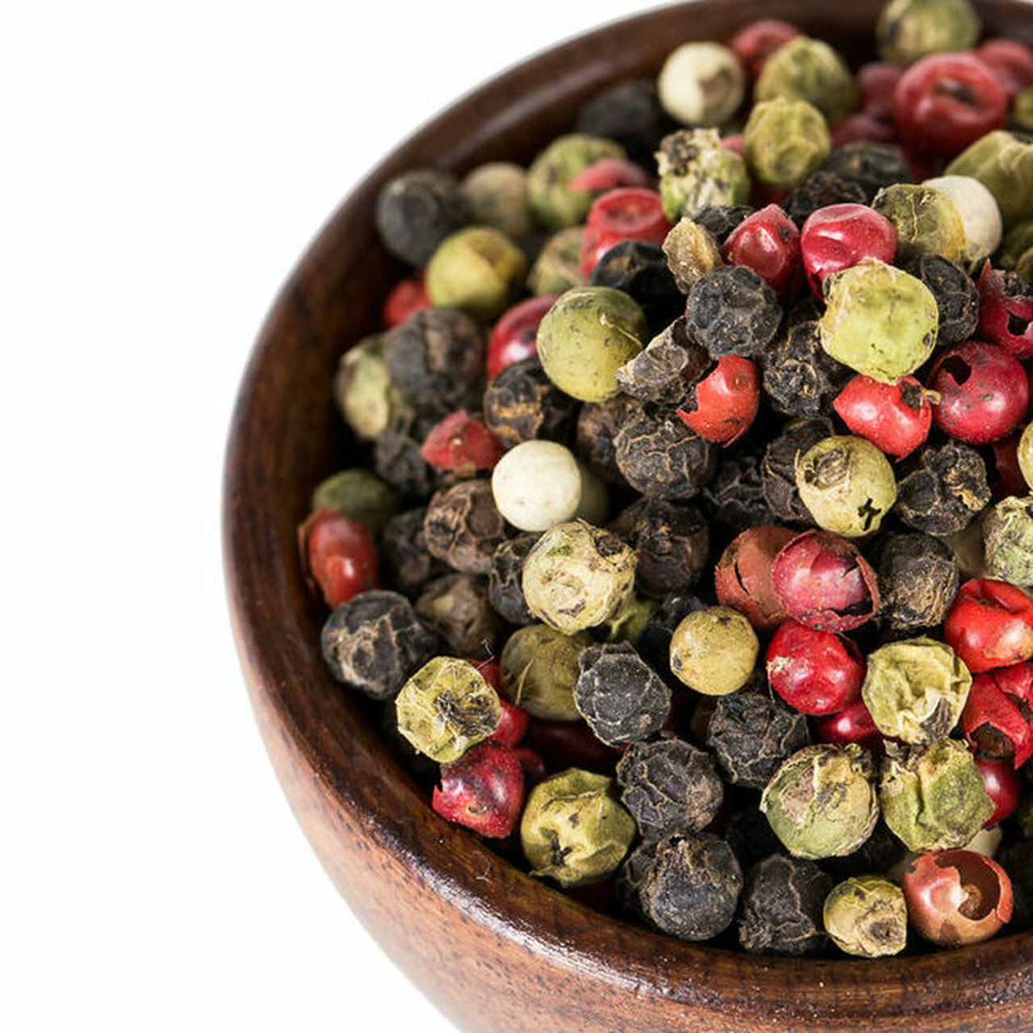



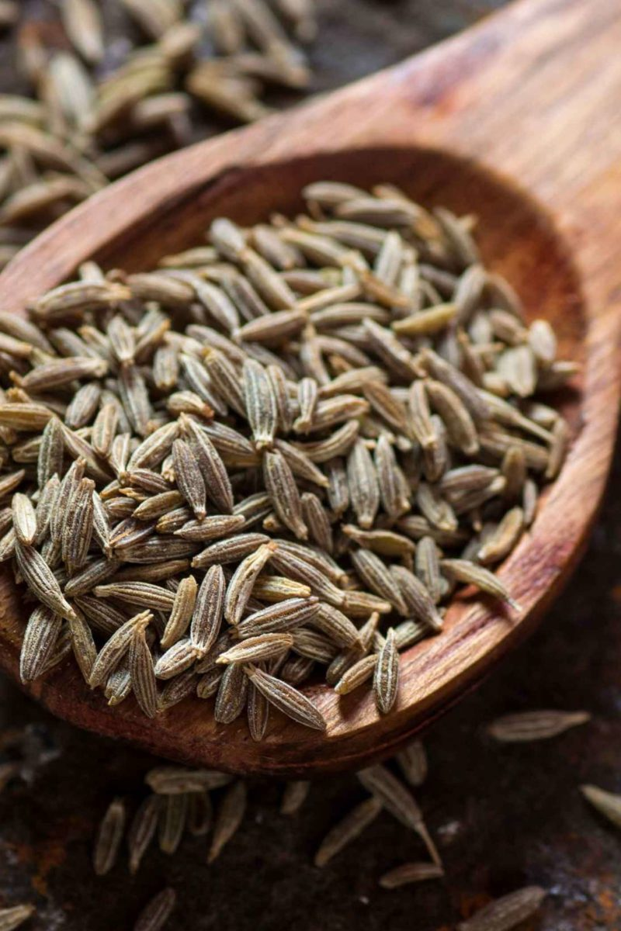

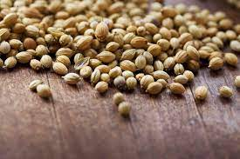
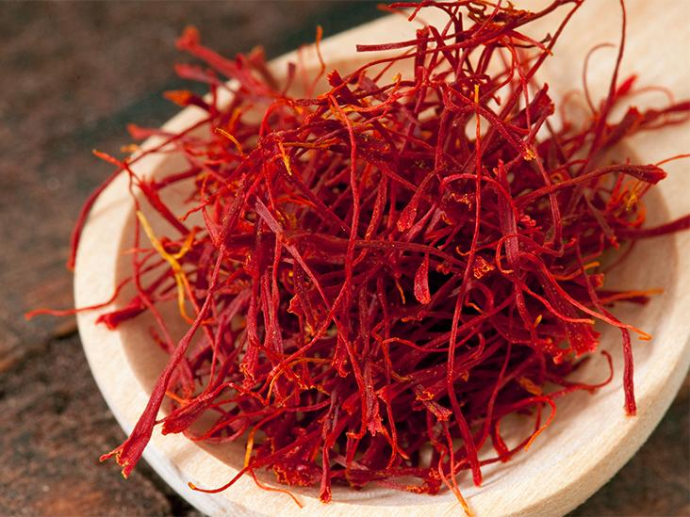



Slide 3
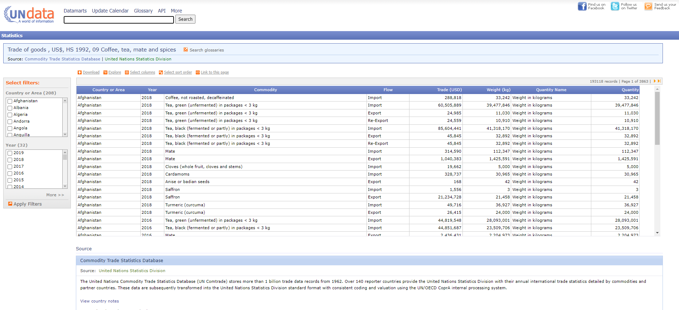
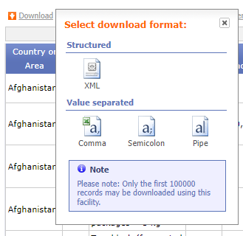
Why choose this topic?
Easy and open access to data files in a usable format.
http://data.un.org/Data.aspx?d=ComTrade&f=_l1Code%3a10

Slide 4
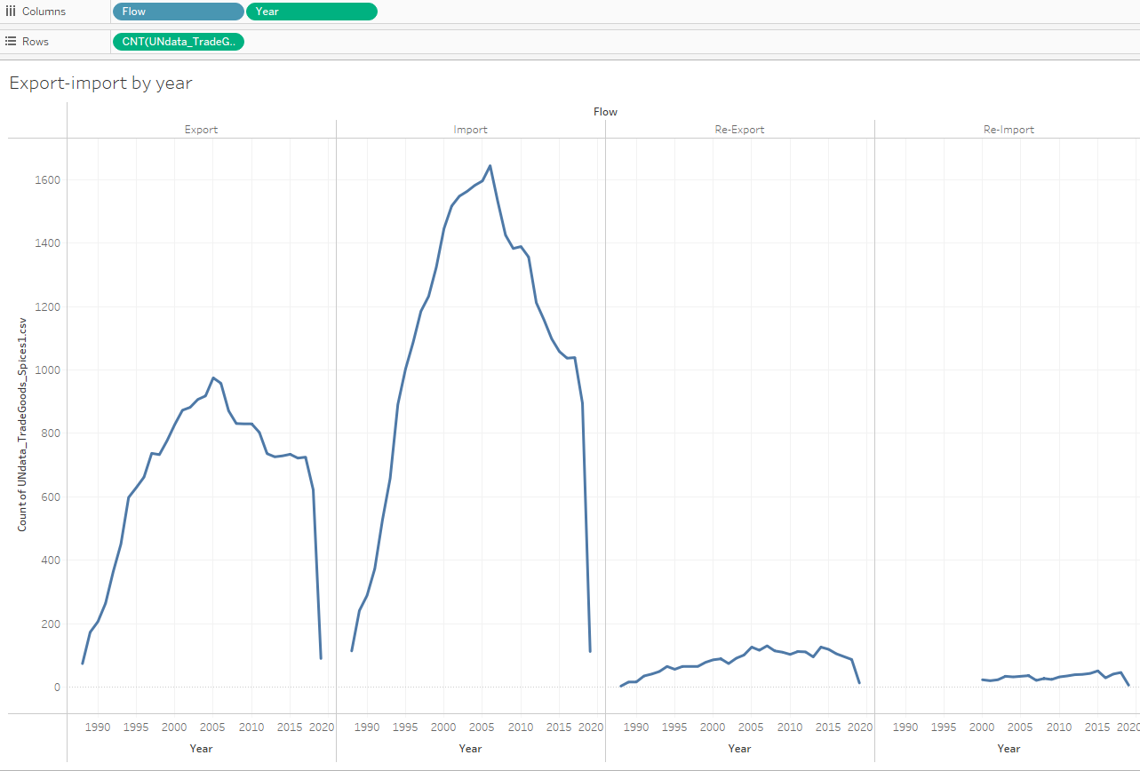
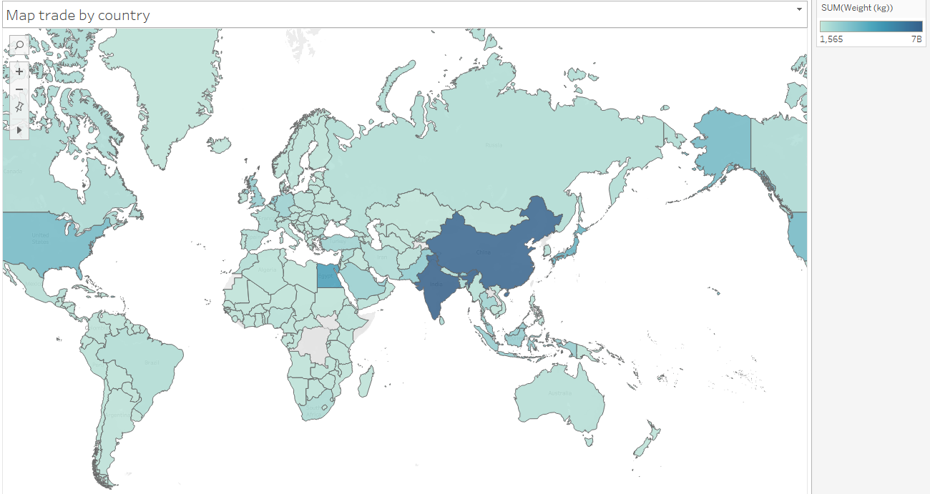
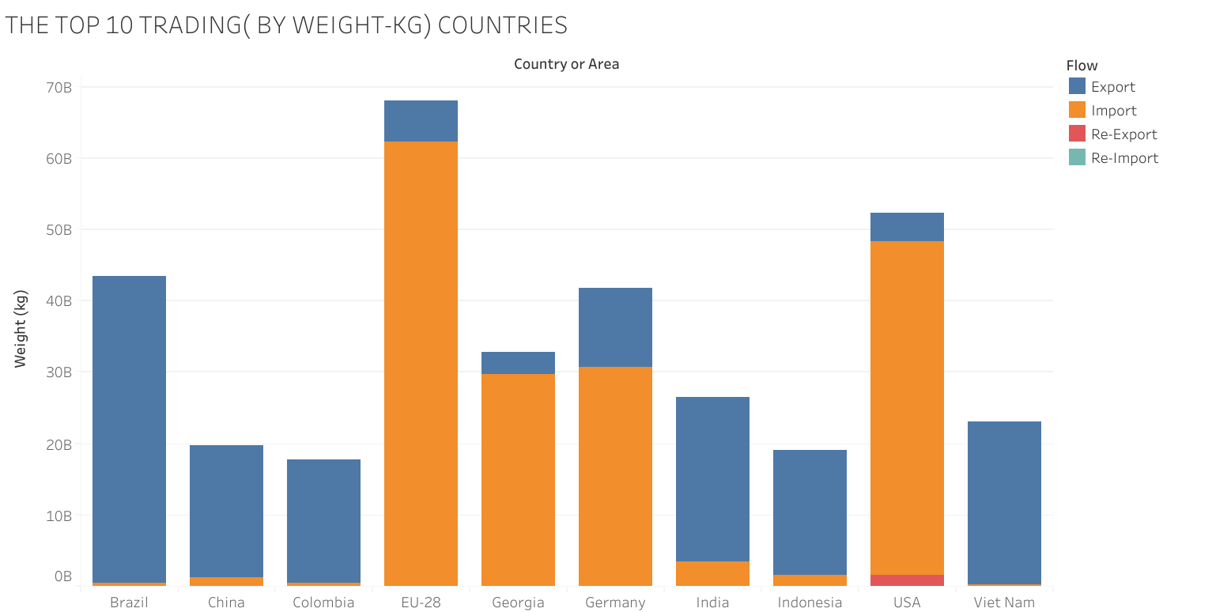
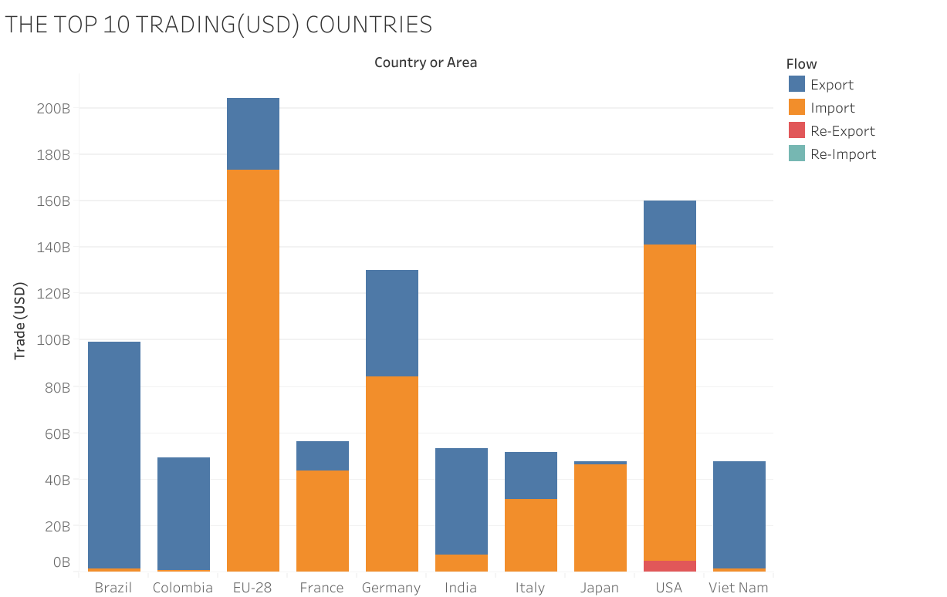
First Task: Exploratory Analysis with Tableau

Slide 5
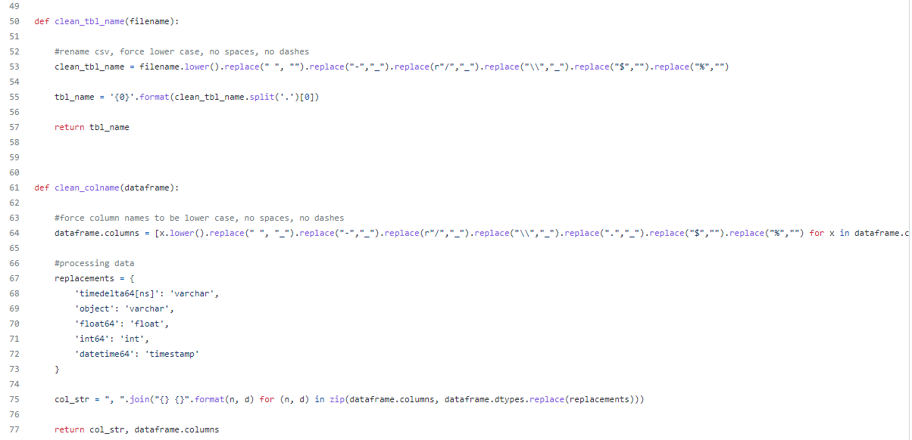
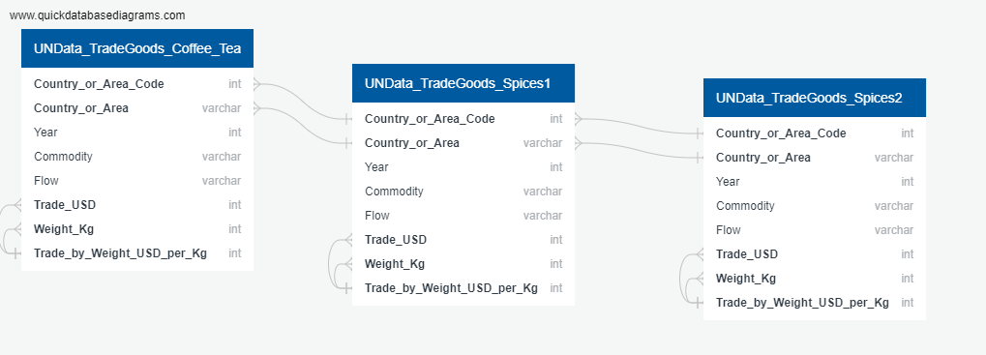

Building a Database Server

Slide 6
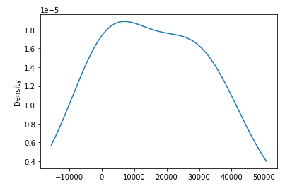
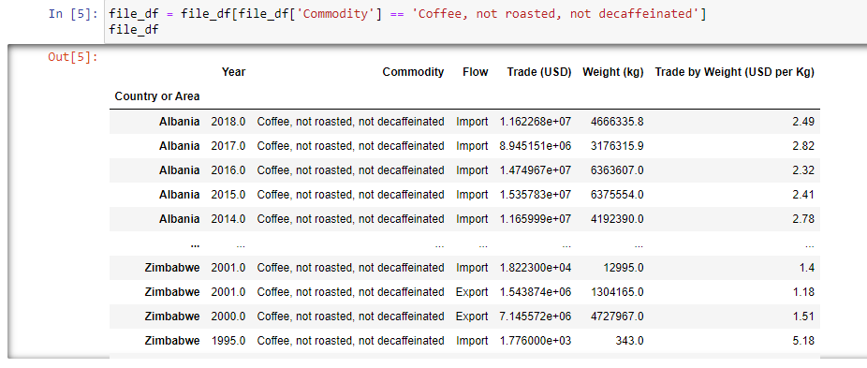
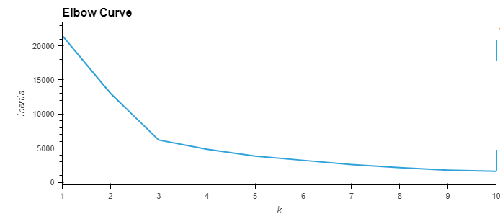
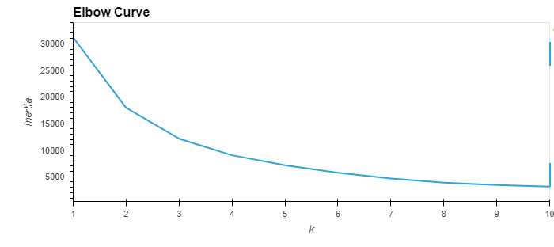
Running the Data through Machine Learning

Slide 7
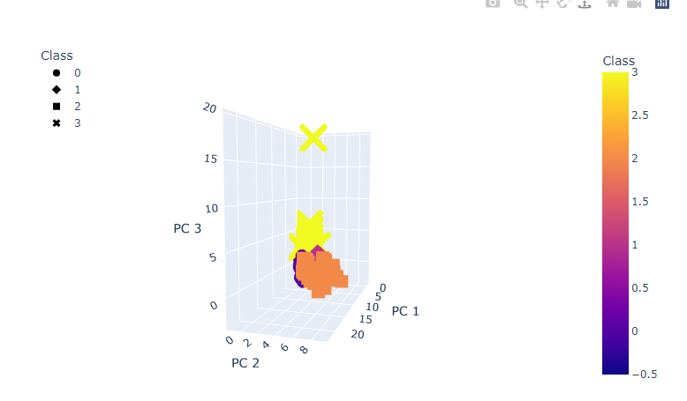
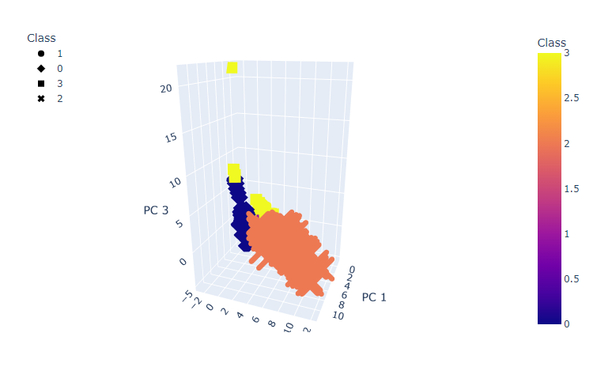
Conclusions

Slide 8
Future Developments
Build a working HTML5 dashboard to select commodities on the machine learning program.
Integrate shipping cost information into analysis.
Further expand by finding the latest trade data, to test out new hypothesis.

